Slide 1



Java MVC Frameworks
Filters and User Authentication
SoftUni Team
Technical Trainers
Software University
http://softuni.bg

Slide 2
Table of Contents
Filters
User Authentication
What’s Spring Security?
Cross-Site Request Forgery
What’s Thymeleaf Security?

Slide 3
Have a Question?
sli.do #java-web

Slide 4

Filters

Slide 5
Filters
A filter is an object used to intercept the HTTP requests and responses of your application
We can perform two operations at two instances:
Before sending the request to the controller
Before sending a response to the client

Slide 6
Filter Example(1)
GreetingFilter.java
@Component
public class GreetingFilter implements Filter {
@Override
public void doFilter(ServletRequest servletRequest, ServletResponse servletResponse, FilterChain filterChain) throws IOException, ServletException {
HttpServletRequest request = (HttpServletRequest) servletRequest;
HttpServletResponse response = (HttpServletResponse) servletResponse;
request.getSession().setAttribute("name", "Pesho");
filterChain.doFilter(request, response);
}
}

Slide 7
Filter Example(2)
HomeController.java
@Controller
public class HomeController {
@GetMapping("/")
public ModelAndView index(ModelAndView modelAndView, HttpSession session) {
modelAndView.setViewName("index");
modelAndView.addObject("name", session.getAttribute("name"));
return modelAndView;
}
}

Slide 8
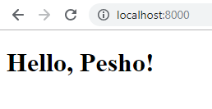
Filter Example(3)
index.html
<!DOCTYPE html>
<html lang="en" xmlns="http://www.w3.org/1999/xhtml" xmlns:th="http://www.thymeleaf.org">
<head>
<meta charset="UTF-8">
<title>Filter Demo</title>
</head>
<body>
<h1 th:text="'Hello, ' + ${name} + '!'"></h1>
</body>
</html>

Slide 9

Spring Security

Slide 10


Spring Security
Framework that focuses on providing both authentication and authorization
Authentication
Authorization

Slide 11



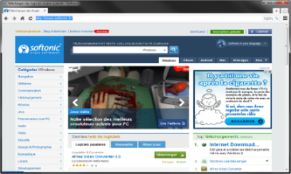



Spring Security Mechanism
Authentication Manager
Access Decision Manager
Intercept
Request
Intercept
Request
Secured Resources
Web Client
GET username password
Valid Credentials
Valid Authorization
Validate
username password
Validate Roles
Database

Slide 12
Spring Security Maven
pom.xml
<dependency>
<groupId>org.springframework.boot</groupId>
<artifactId>spring-boot-starter-security</artifactId>
</dependency>

Slide 13
Spring Security Configuration (1)
Extending the WebSecurityConfigurerAdapter class.
SecurityConfiguration.java
@Configuration
@EnableWebSecurity
public class SecurityConfiguration extends WebSecurityConfigurerAdapter {
//Configuration goes here
}
Enable Security

Slide 14
Spring Security Configuration (2)
Overriding configure() method.
SecurityConfiguration.java
@Override
protected void configure(HttpSecurity http) throws Exception {
http
.authorizeRequests()
.antMatchers("/", "/register").permitAll()
.anyRequest().authenticated()
}
Authorize Requests
Permit Routes
Require Authentication

Slide 15
Registration - User
Implementing the UserDetails interface.
User.java
@Entity
public class User implements UserDetails {
private String username;
private String password;
private boolean isAccountNonExpired;
private boolean isAccountNonLocked;
private boolean isCredentialsNonExpired;
private boolean isEnabled; private Set<Role> authorities;
}

Slide 16

Registration - Roles
Implementing the GrantedAuthority interface.
Role.java
public class Role implements GrantedAuthority {
private String authority;
}
Role Interface

Slide 17
Registration - UserService
Implementing the UserDetailsService interface.
UserServiceImpl.java
@Service
public class UserServiceImpl implements UserDetailsService {
@Autowired
private BCryptPasswordEncoder bCryptPasswordEncoder;
@Override
public void register(RegisterModel registerModel) { bCryptPasswordEncoder.encode(password));
} }
Encrypt Password

Slide 18
Registration - Configuration
Disabling CSRF protection temporarily.
SecurityConfiguration.java
@Override
protected void configure(HttpSecurity http) throws Exception {
http
.and()
.csrf().disable();
}
Disable CSRF

Slide 19

Login Mechanism
Web Client
Create Session
GET localhost:8080
Session Cookie
Validate Session
GET localhost:8080
Session Cookie

Slide 20
Login - Configuration
SecurityConfiguration.java
.and()
.formLogin().loginPage("/login").permitAll()
.usernameParameter("username")
.passwordParameter("password")
login.html
<input type="text" name="username"/>
<input type="text" name="password"/>

Slide 21
Login - UserService
UserServiceImpl.java
@Service
public class UserServiceImpl implements UserDetailsService {
@Autowired
private BCryptPasswordEncoder bCryptPasswordEncoder;
@Override
public UserDetails loadUserByUsername(String username) throws
UsernameNotFoundException {
} }
User Service Interface

Slide 22
Login - Controller
LoginController.java
@Controller
public class LoginController {
@GetMapping("/login")
public String getLoginPage(@RequestParam(required = false) String error, Model model) {
if(error != null){
model.addAttribute("error", "Error");
}
return "login";
} }
Error Handling

Slide 23
Logout
SecurityConfiguration.java
.and()
.logout().logoutSuccessUrl("/login?logout").permitAll()
Logout. No Controller is required

Slide 24
Principal
This is the currently logged user
UserController.java
@GetMapping("/user")
public String getUser(Principal principal){
System.out.println(principal.getName());
return "user";
}
Print Logged-In username

Slide 25
Pre / Post Authorize
Grant Access to specific methods
Enables PreAuthorize
SecurityConfiguration.java
@EnableGlobalMethodSecurity(prePostEnabled = true)
public class SecurityConfiguration extends WebSecurityConfigurerAdapter { }
UserService.java
public interface UserService extends UserDetailsService {
@PreAuthorize("hasRole('ADMIN')")
void delete();
}
Requires Admin Role to execute

Slide 26
No Access Handling
SecurityConfiguration.java
.and()
.exceptionHandling().accessDeniedPage("/unauthorized");
AccessController.java
@GetMapping("/unauthorized")
public String unauthorized(){
return "unauthorized";
}

Slide 27
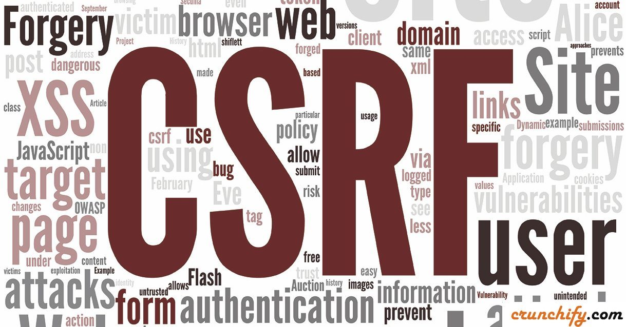
CSRF
Cross-Site Request Forgery

Slide 28
Spring CSFR Protection
AccessController.java
.csrf()
.csrfTokenRepository(csrfTokenRepository())
private CsrfTokenRepository csrfTokenRepository() {
HttpSessionCsrfTokenRepository repository =
new HttpSessionCsrfTokenRepository();
repository.setSessionAttributeName("_csrf");
return repository;
}
form.html
<input type="hidden" th:name="${_csrf.parameterName}" th:value="${_csrf.token}" />

Slide 29
Thymeleaf Security

Slide 30
Thymeleaf Security
Functionality to display data based on authentication rules
pom.xml
<dependency>
<groupId>org.thymeleaf.extras</groupId>
<artifactId>thymeleaf-extras-springsecurity4</artifactId>
</dependency>

Slide 31
Principal
pom.xml
<!DOCTYPE html>
<html lang="en"
xmlns:th="http://www.thymeleaf.org"
xmlns:sec="http://www.thymeleaf.org/extras/spring-security">
<body>
<div sec:authentication="name">
The value of the "name" property of the authentication object should appear here.
</div>
</body>
</html>
Show the username

Slide 32
Roles
pom.xml
<!DOCTYPE html>
<html lang="en"
xmlns:th="http://www.thymeleaf.org"
xmlns:sec="http://www.thymeleaf.org/extras/spring-security">
<body>
<div sec:authorize="hasRole('ADMIN')">
This content is only shown to administrators.
</div>
</body>
</html>
Show if you are admin

Slide 33


Summary
Spring Security – framework that focuses on providing both authentication and authorization
Thymeleaf Security – functionality to display data based on authentication rules

Slide 34
https://softuni.bg/trainings/courses

Slide 35













SoftUni Diamond Partners

Slide 36





SoftUni Organizational Partners

Slide 37




Trainings @ Software University (SoftUni)
Software University – High-Quality Education and Employment Opportunities
softuni.bg
Software University Foundation
http://softuni.foundation/
Software University @ Facebook
facebook.com/SoftwareUniversity
Software University Forums
forum.softuni.bg

Slide 38

License
This course (slides, examples, demos, videos, homework, etc.) is licensed under the "Creative Commons Attribution-NonCommercial-ShareAlike 4.0 International" license

